Slide 1
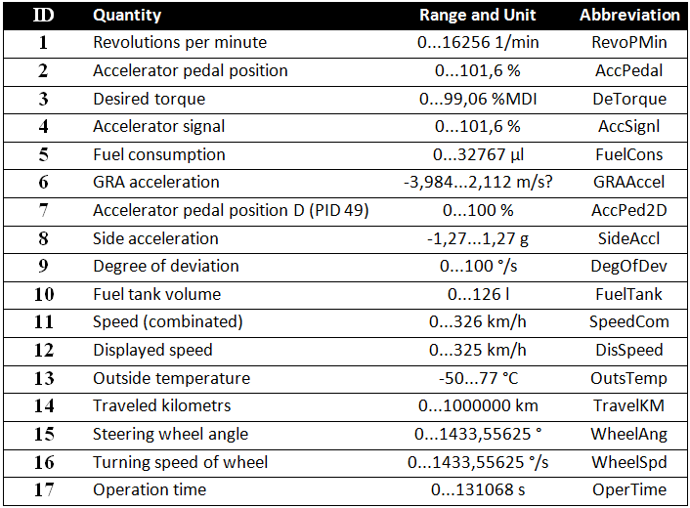
There is one binary file for each of the drive tests. The file contains record of the data captured from the vehicle CAN bus. This file is parsed into 17 text files, one for each of the observed quantities. The files contain two columns, one for timestamps and the other for the values of the observed quantity. The list of the quantities used is presented in the table below.
One test drive takes approximately 30 minutes and is linked to a given state of the driver's alertness. The state of the drivers alertness is considered fixed for the test drive. The driver's alertness is expressed in levels ranging from 1 (excellent) to 5 (very poor). Assessment of the driver alertness level is based on results of the flicker test prior the drive, right after the drive (measurements are done in the car) and on the subjective feeling of the driver.

